Slide 1
Beyond CS Bridge

Slide 2
Plan For Today
Where We’ve Been
Where We Can Go Next
Learning Resources
Python
Thank you!

Slide 3
Plan For Today
Where We’ve Been
Where We Can Go Next
Learning Resources
Python
Thank you!

Slide 4
Quick Recap
Karel
Control Flow
Variables
Control Flow Revisited
Graphics
Functions
Nested Loops
Animation
Lists
Mouse
Breakout
Keyboard
Dictionaries
Artificial Intelligence
Images
Notes:
Nick

Slide 5
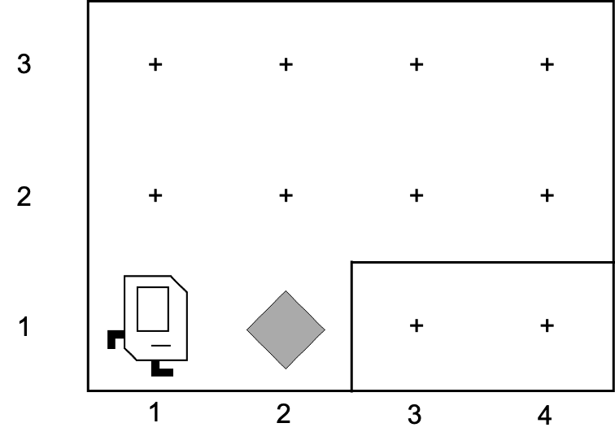
First Day

Slide 6
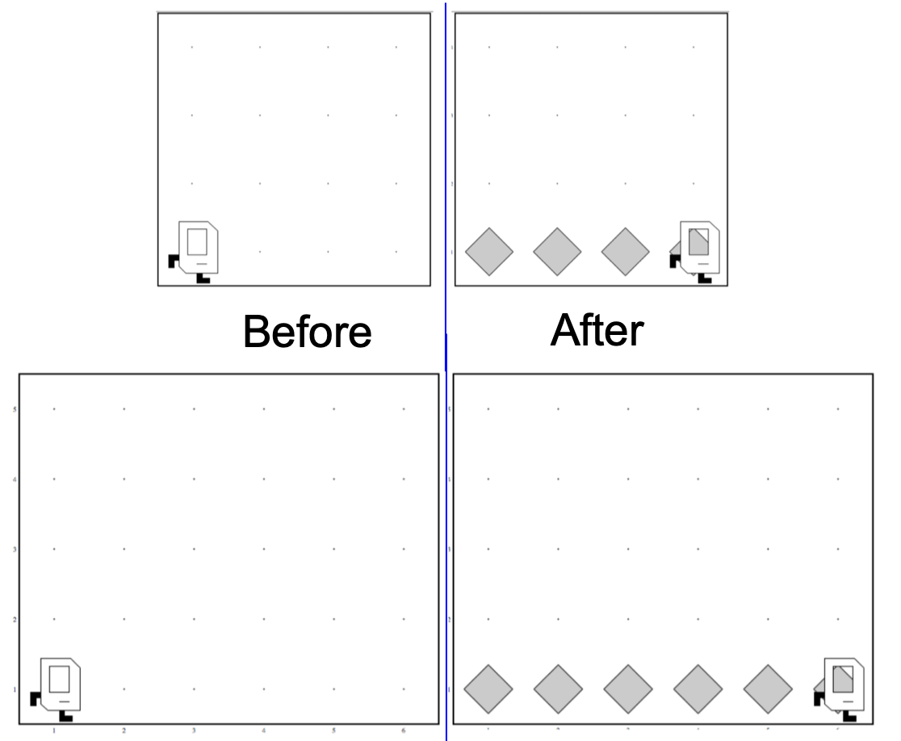
Generalization

Slide 7

Variables

Slide 8
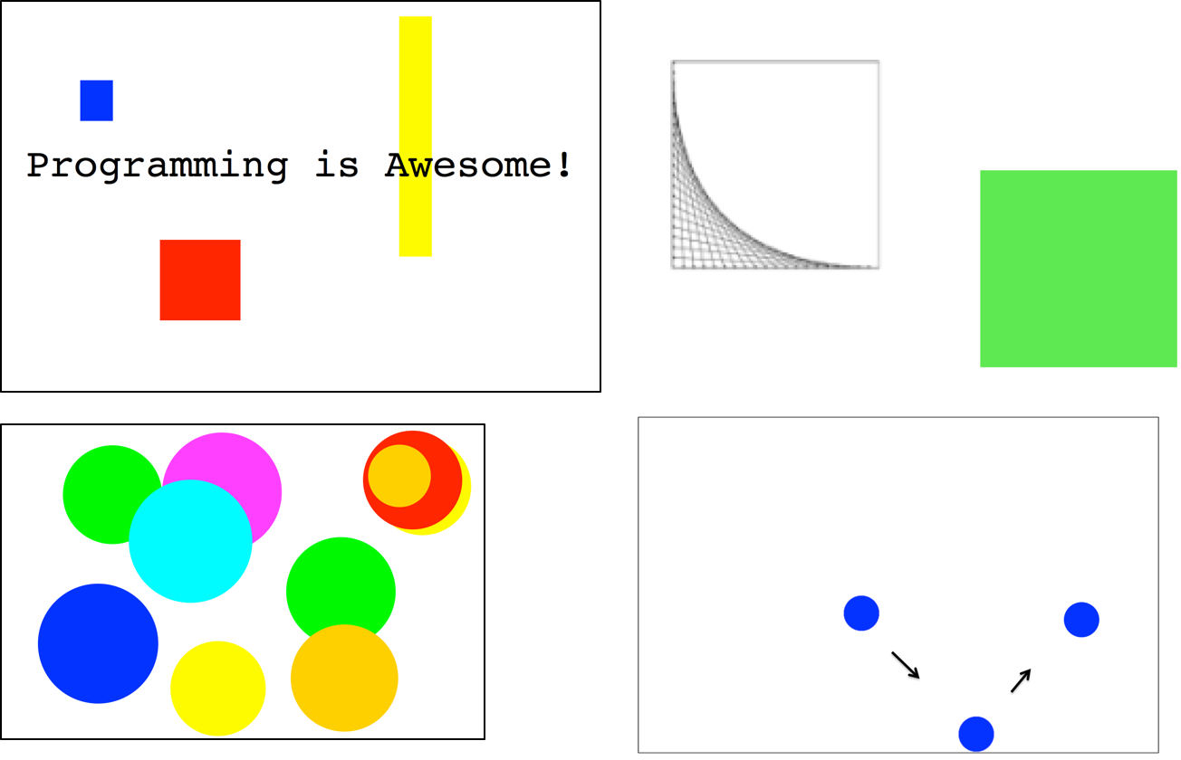

Graphics

Slide 9
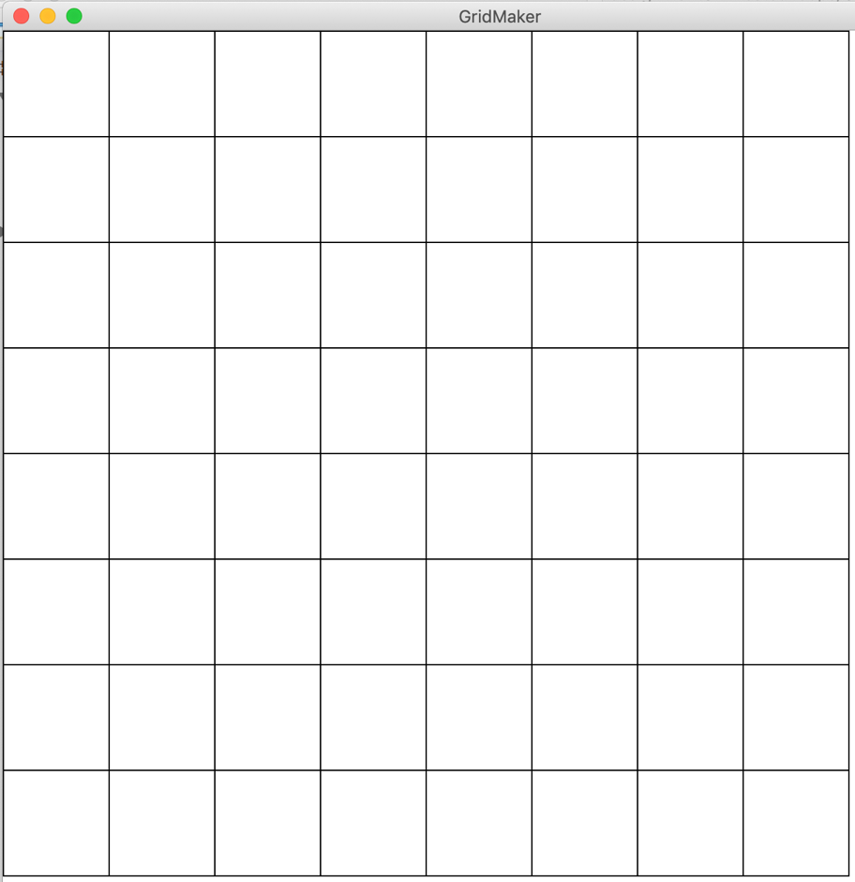
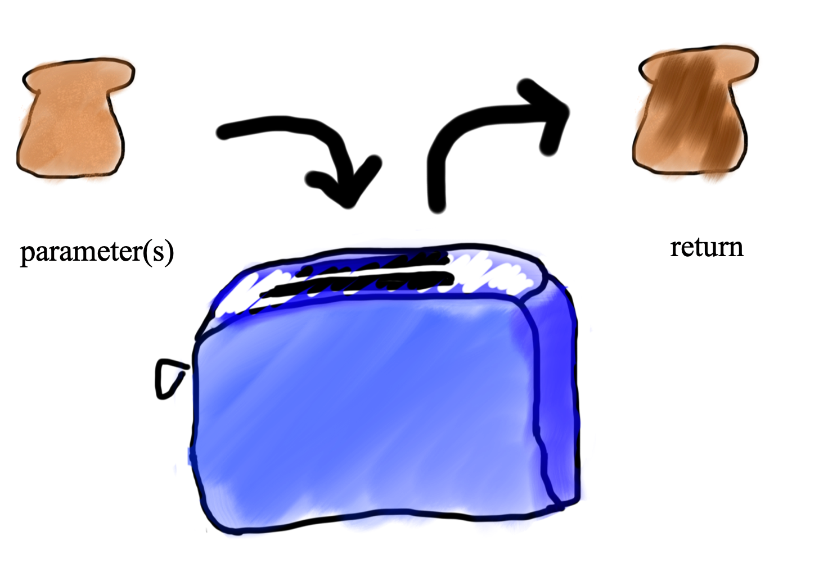
Functions and Advanced Loops

Slide 10
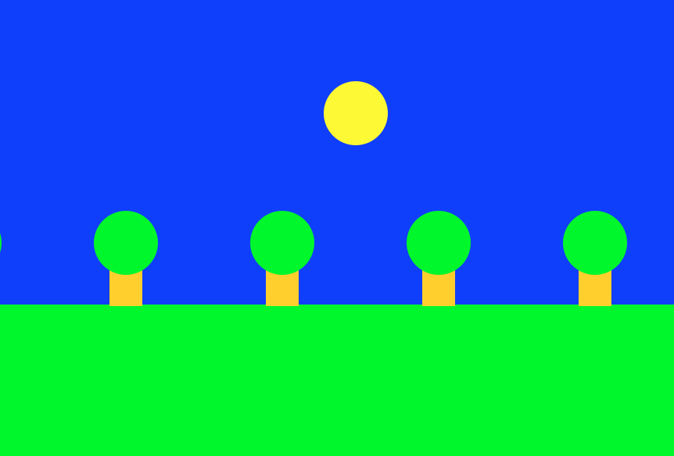
Animation

Slide 11


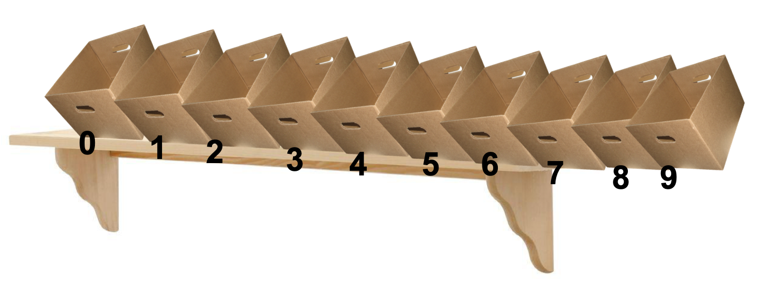
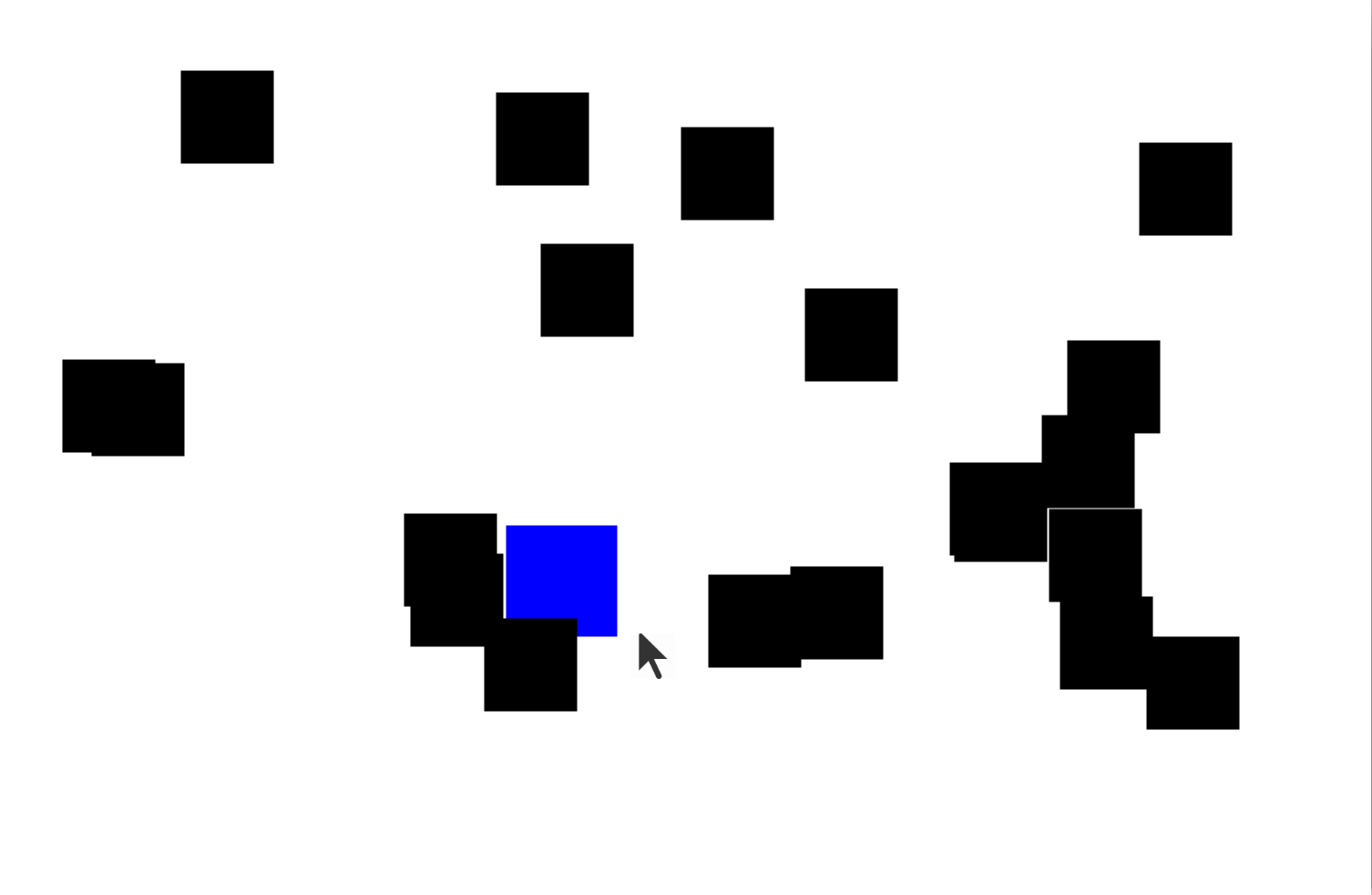
Lists and The Mouse

Slide 12
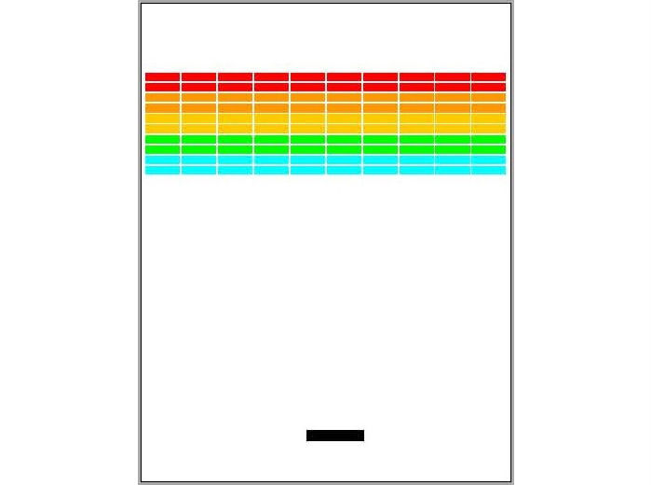
Breakout

Slide 13
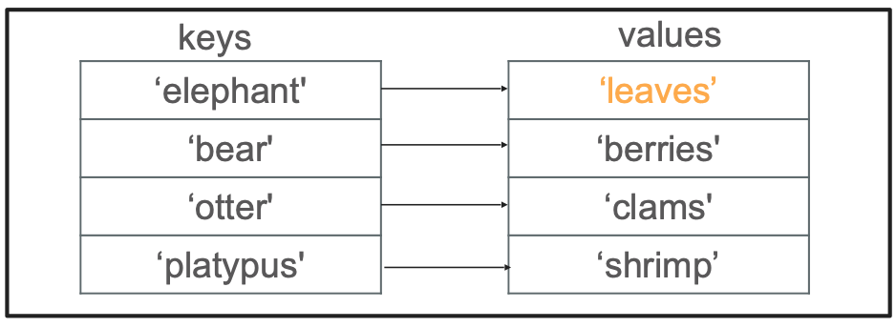
Dictionaries

Slide 14
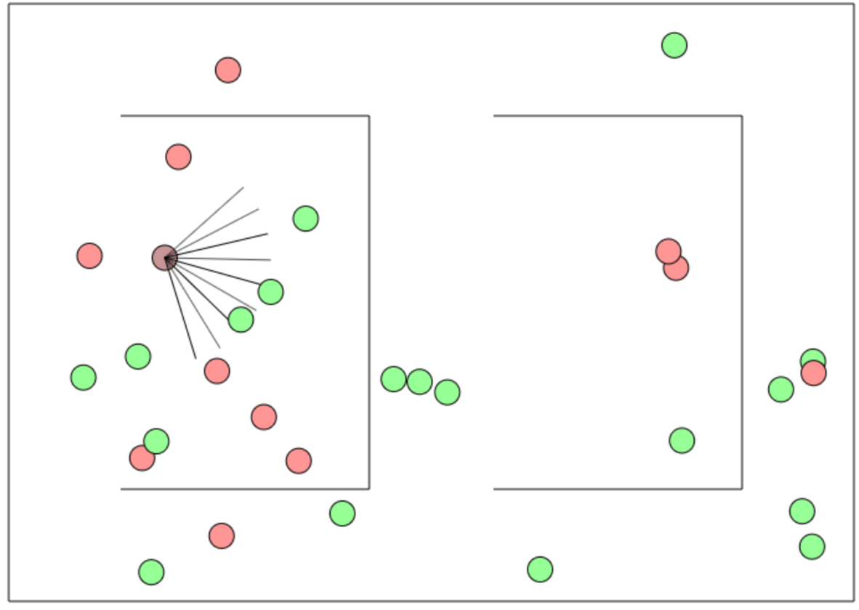
AI

Slide 15

Final Project

Slide 16
Plan For Today
Where We’ve Been
Where We Can Go Next
Learning Resources
Python
Thank you!

Slide 17
Self-study
https://see.stanford.edu/Course/CS106A (Java)
https://web.stanford.edu/class/archive/cs/cs106a/cs106a.1206/ (Python)
https://online.stanford.edu
https://coursera.org
https://khanacademy.org
https://pluralsight.com
https://docs.python.org/3/
https://ohlone.csbridge.org
Notes:
Eliska + Ondra

Slide 18
Self-study
But what is a neural network?
https://www.youtube.com/watch?v=aircAruvnKk
The Essence of Calculus
https://www.youtube.com/watch?v=WUvTyaaNkzM
Notes:
Eliska + Ondra

Slide 19
Self-study
Lots of practice!
Notes:
Eliska + Ondra

Slide 20
Useful download links
https://www.jetbrains.com/pycharm/
Notes:
Eliska + Ondra

Slide 21
Using Python Packages
Demo: Installing python packages
Notes:
Eliska + Ondra

Slide 22
What else is out there?
Notes:
Eliska + Ondra

Slide 24
Fizzbuzz
Fizzbuzz is a classic coding problem.
In the game Fizz Buzz, players take turns counting up from one. If a player’s turn lands on a number that’s divisible by 3, she should say “Fizz” instead of the number, and if it lands on a number that’s divisible by 5, she should say “Buzz” instead of the number. If the number is both a multiple of 3 and of 5, she should say "Fizzbuzz" instead of the number. A spectator sport, it is not. What it is, however, is an interesting problem in control flow and parameter usage.

Slide 25
Fizzbuzz
1
2
Fizz
4
Buzz
Fizz
7
8
Fizz
Buzz
11
Fizz
13
14
Fizzbuzz
16

Slide 26
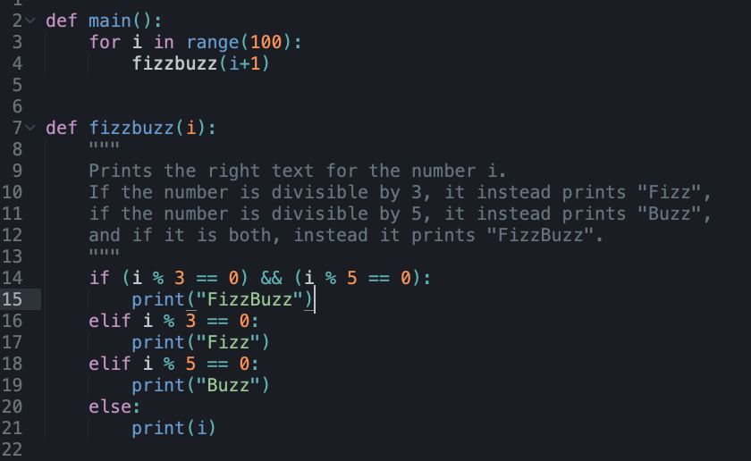
Fizzbuzz (Python)

Slide 27
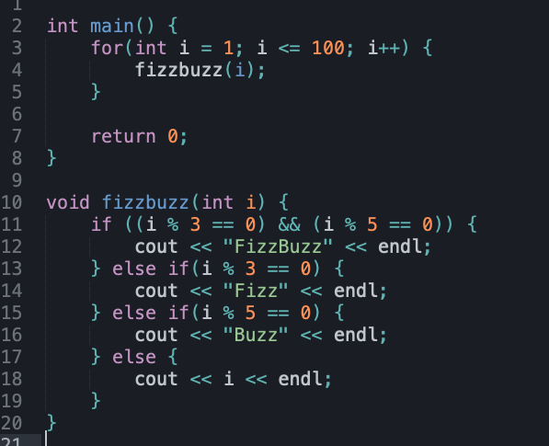
Fizzbuzz (C++)

Slide 28
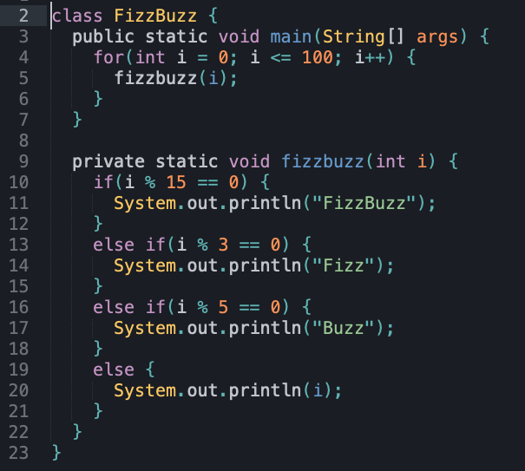
Fizzbuzz (Java)

Slide 29
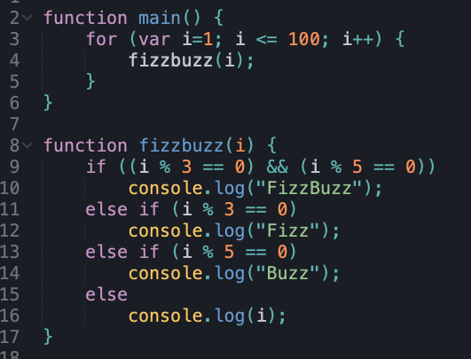
Fizzbuzz (JavaScript)

Slide 30
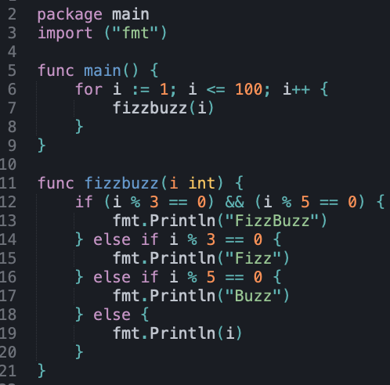
Fizzbuzz (Go)

Slide 31
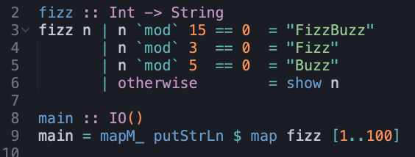
Fizzbuzz (Haskell)

Slide 32
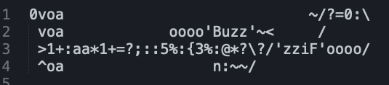
Fizzbuzz (><>)

Slide 34
There are a lot of programming languages!

Slide 35
There are a lot of programming languages!
But they all share the same core concepts

Slide 36


Slide 37
Stay in touch!
https://us.edstem.org/courses/968/discussion/
Notes:
Eliska + Ondra

Slide 38
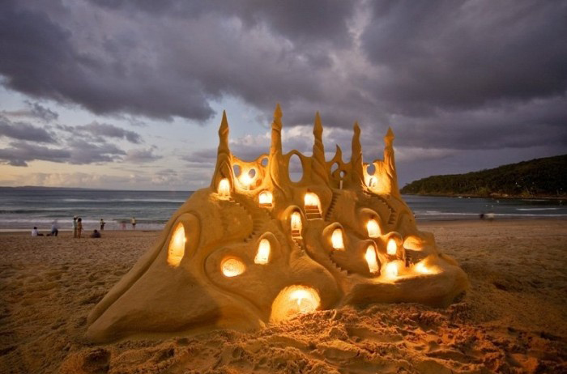
Joy of Building

Slide 39

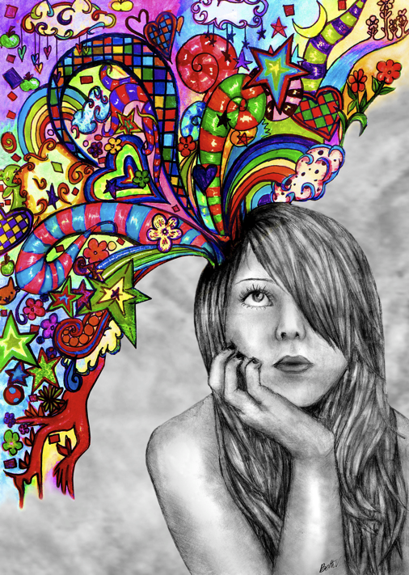
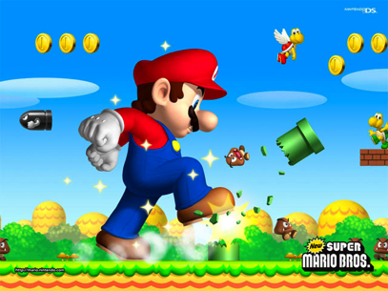
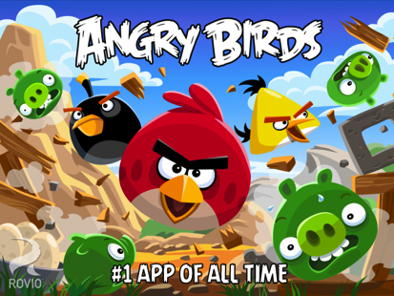
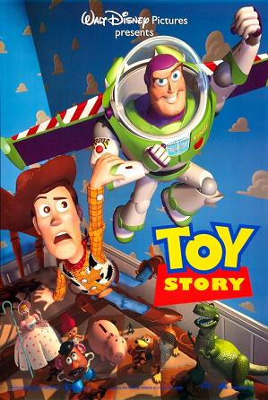
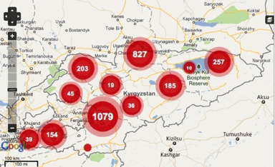
Notes:
Super Mario: Japan
Angry Birds: Finland
Pixar: USA
Ushahidi: Kenya

Slide 40

Closest Thing to Magic

Slide 41
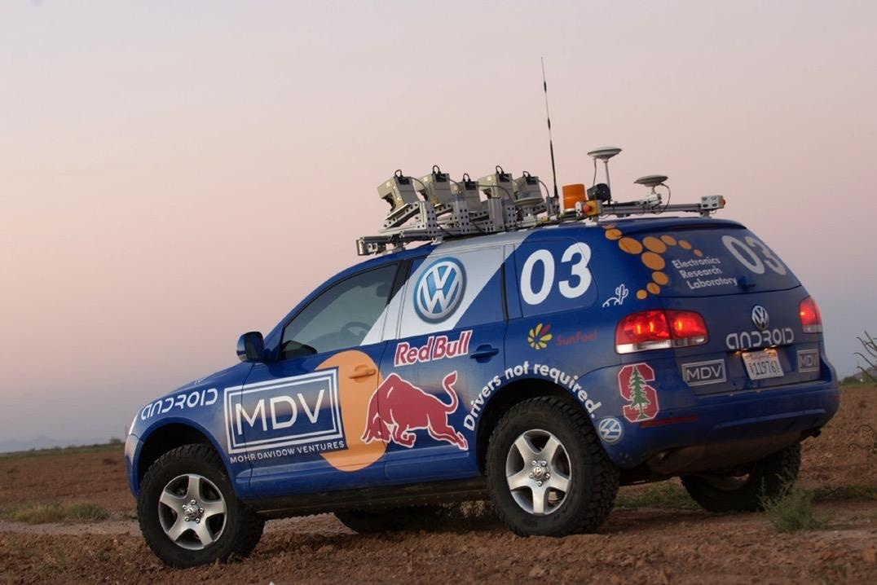
Now is the time!

Slide 42
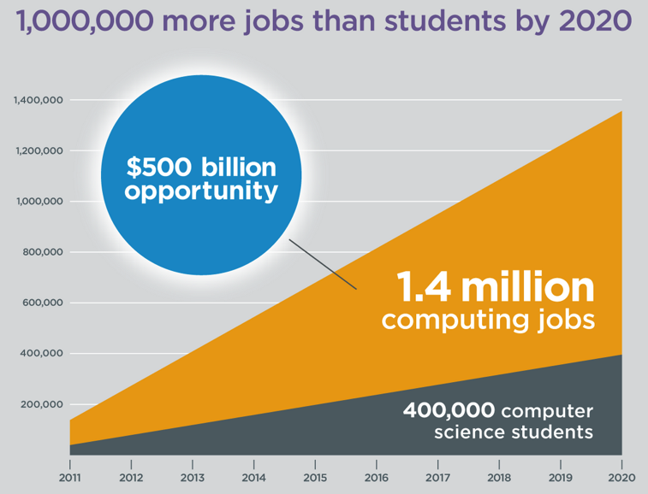
Oh and it’s useful
Code.org

Slide 43
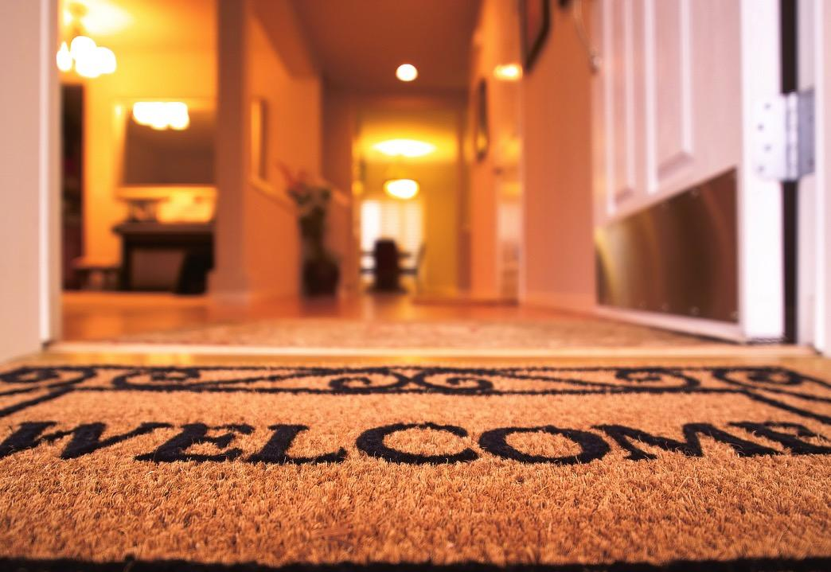
Everyone is welcome
Tell your friends :-)

Slide 44


Keep Learning by Doing
# good life
while True:
learn()
play()
love()
time.sleep(8)

Slide 45
We hope we excited you about learning more computer science!
Notes:
Not nearly enough adults in the world are able to do what you have now demonstrated!

Slide 46
You should be proud of yourselves
Notes:
Not nearly enough adults in the world are able to do what you have now demonstrated!

